Slide 1
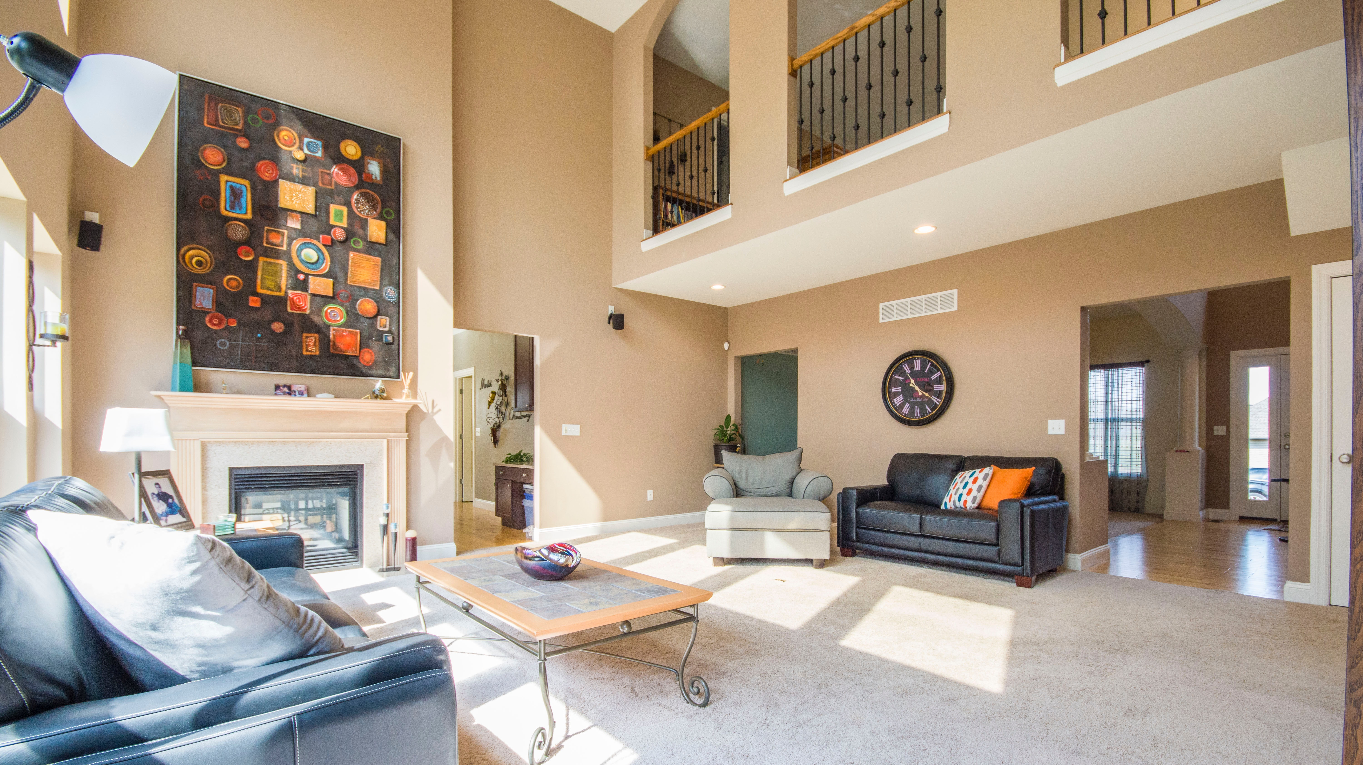
Market Analysis between NY and Beijing
Business Analyst | Pei-Chih Chao

Slide 2



What make the markets different?
01
02
03
Pricing
Quality
Size
Hotels are really expensive in North America; however, there are many business hotels provide rooms at low prices.
When we talk about the quality of buildings, those in North America are much higher than in China.
Houses in North America are bigger than in China. Bigger size provides a better housing experience.

Slide 3
Rooms and Hosts in New York and Beijing
Num of Rooms
Num of Hosts
Beijing
25,921
9,946
New York
49,748
37,689

Slide 4
Average Prices and Numbers of Reviews
Average
Prices
Per
Night
Beijing
$100
New York
$150
Numbers
Of
Reviews
Beijing
180,561
New York
1,106,639

Slide 5

“(Airbnb’s) China rival, Xiaozhu, raises nearly $300 million from Jack Ma fund.”
-Reuters

Slide 6
Thank you!

